Slide 1
Welcome to Mrs. Howland’s Kindergarten

Slide 2
Arrival & Morning Work
Students come in, unpack and put things in their cubbies, turn in their communication folders for review, and immediately start morning work.

Slide 3
Morning Meeting
During morning meeting, students review the days of the week, months of the year, count the days in the month, create or add to a pattern, and forecast the weather. This is where we start our day by discussing what is to be expected in the hours to come. This is also the time where the children get the opportunity to share their own special thoughts or news with the class.

Slide 4
Literacy Centers
Literacy centers are stations where literacy activities are set up for independent or guided use. Examples of literacy centers include: reading the room, matching upper and lowercase letters or word families, doing “picture walks” through theme related books, reading to a buddy, and listening to reading on the computer or in the listening center. This allows the teacher to pull students to read in their small reading groups. These groups are differentiated to meet the specific needs and reading level of your child.

Slide 5
Shared Reading
Shared Reading is an interactive reading experience that occurs when students join in or share the reading of a big book while guided and supported by a teacher or other experienced reader. Students observe an expert reading the text with fluency and expression. The text must be large enough for all the students to see clearly, so they can share in the reading of the text. It is through Shared Reading that the reading process and reading strategies that readers use are demonstrated.

Slide 6
Word Work
Phonics is the awareness of letter and sound relationships. It is the link between what we say and what we can read and write. Phonics is taught in a variety of ways including: letter recognition, connecting the letters with their sounds, teaching and reinforcing sight words, and reading and writing easy consonant-vowel-consonant words. We will introduce new “Word Wall Words” gradually so that by the end of Kindergarten students will have a core of sight words that they can read and write.

Slide 7
Interactive Writing
Interactive writing is when the teacher "shares her pen" with the children to collaboratively compose a written message. The children contribute the letter sounds that they hear and the teacher writes the rest. Through this process students learn that words are made up of sounds in sequence and develop early concepts about print such as starting on the left and using spaces between words. Through interactive writing students begin to acquire some early high frequency words, learn that what you say can be written down and what you write can be read.

Slide 8
Handwriting
Learning to write can be stressful for students who may need practice with their fine motor skills. Children learn to print using hands-on materials and developmentally appropriate activities such as individual whiteboards, tracing in sand or even shaving cream! This fine motor practice prepares students for pencil and paper success .

Slide 9
Lunchtime
At lunchtime, the children are taken to the dining hall and are seated at table F. Students that pack their lunch immediately go to their assigned table. Students that buy are given a clothespin with their name and student ID number attached to their shirts to enter at the register. In the cafeteria, the students follow a two cup system. For the first five minutes the red cup is displayed which means silent. After that time is up, the green cup is displayed to signify inside voices.

Slide 10
Writing Workshop
During Writing Workshop, we start with a mini-lesson focusing on a specific skill, followed by independent writing time where the children can use inventive spelling and also refer to the print our rooms. While students are working independently, the teacher pulls students to conference each individually or in small groups focusing on a specific skill. Following independent writing, students are given the opportunity to share their work with the class.

Slide 11
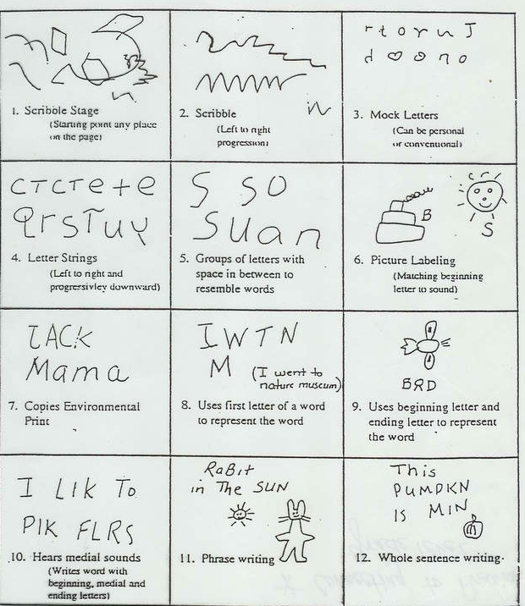

Slide 12
Specials
Every day the children get the opportunity to go to a “Specials” class. The Special area classes that the children will attend are: Art, Music, Physical Education, Technology, Media, and Counseling .

Slide 13
Math
Math time is spent working on several skill areas including: developing a sense of numbers 1-100, reading and writing numerals, comparing and ordering sets, numbers, shapes and attributes of two objects using appropriate vocabulary (color, weight, height, width, length, texture). A normal math session usually includes a math related story, manipulative work on the white board, and counting exercises. In all parts of the mathematics program children learn by doing. The classroom is set up so that children can actively explore, investigate, estimate, make predictions, count, build, and talk about their ideas. Children are encouraged to tell how they arrive at their answers and to look for alternative ways to solve problems.

Slide 14
Snack & Read Aloud
Snack time is an opportunity for the children to learn social skills as they chat with friends at their table. During this time we also share a read aloud of the children’s choice.

Slide 15
Outdoor PE
Outdoor play refines a child's gross-motor and very important social skills. Playground time is also an opportunity to explore and manipulate a different environment. Children love outdoor play because they can let loose their imaginations while getting physical.

Slide 16
Social Studies
During Social Studies, the children will discuss and gain a better understanding of citizenship, how we are alike and different, cultures around the world, needs and wants, and geography.

Slide 17
Science
During science, students will make observations and build an understanding of similarities and differences in animals, weather concepts, and the properties of common objects. They will also use appropriate tools and measurements to increase their ability to describe their world. FOSS kits are used for our science classes which allow for the children to have authentic, hands-on learning experiences.

Slide 18
Rest & Read
This is the time of day set aside for the children to relax after a full day of exercising their brains. The children will sit at their seats with a book of their choice to rest and read quietly before dismissal.

Slide 19
Dismissal
At Alston Ridge, we have a silent dismissal that is done entirely on the television. During this time, students traveling home via carpool and daycare vans are given color coded tags. The students watch each mode of transportation be announced on the television through the use of appropriate symbols (car, numbered buses, after school care). If a student were to forget his or her bus number, he or she may refer to the “How We Go Home” list. If a child’s mode of dismissal changes, the parent or guardian must call or send a note in to school.

Slide 20
Behavior Management
We have an “apple tree” with each child’s name next to the color they are on for that time. Each child begins the day on green.
If a child does not make good choices throughout the day they will be given a couple of warnings and then they are asked to change to the next color. Green-yellow-red.
If I child moves to red this means they have not demonstrated good choices a few times in the day.
Each day your child will come home with a color for the day. Please sign and return the calendar each day to indicate you have seen it. A short note may also come home if the color is yellow/red. Red usually will be a phone call home.

Slide 21
Warm Fuzzies
I give out warm fuzzies (pom poms) throughout the day to children I see are “caught”being good. This can be from things such as lending a friend a crayon, picking up paper off the floor, raising their hand, etc. The children have a bag to keep their fuzzies in their seat sacks.
Students will have a chance every couple of weeks to “spend” their warm fuzzies at the class store. They are encouraged to save up for the more “expensive” items and not spend it all at once!

Slide 22
Homework
Monthly Homework calendars are optional and will be posted on Blackboard but we ask that you read with your child at least 20 minutes nightly.

Slide 23
Reporting Periods
-1st and 3rd Quarter- Parent/Teacher Conferences will be held to discuss the children’s progress.
-1st through 4th Quarter- Report Cards will be sent home

Slide 24
Field Trips
We usually have about four field trips a year, both on and off campus. The tentative field trips that we are planning on going on this year include: The Ganyard Farm Pumpkin Patch, a musical performance, a visit from the Science Fun For Everyone scientists and the Museum of Life and Science. The dates are still to be determined but we love to have as many parent chaperones as possible to join in on the fun! ☺

Slide 25
Birthday Celebrations
Due to the large number of children in our school with allergies as well as initiatives for healthier students, it is a school wide policy that we do not have food for birthday celebrations. Instead, we invite you to come read a special book chosen by your child to our class and (if you so wish) you can then donate to our classroom library in your child’s name.

Slide 26
Daily Schedule (for first quarter)
8:45-9:15 Morning Work
9:15-9:30 Morning Meeting/Calendar
9:30 – 10:15 Math
10:15-11:00 Writing
11:00-11:10 Bathroom Break
11:10-11:55 Specials
12:00-12:30 Lunch
12:30-12:40 Bathroom Break
12:40-1:00 Shared Reading
1:00-2:15 Daily Five and Phonics
2:15 – 2:30 Snack
2:30 – 3:00 Recess
3:00-3:30 Science/Social Studies
3:30-3:45 Rest & Read/Prep for Dismissal

Slide 27
Absences – For an absence to be excused, a note must be sent in with the student when they return to school.
Wish List – wish list is posted on blackboard, if you would like to donate please take a sticky note today
Volunteers – starting in the 2nd quarter, there will be a sign up genius for volunteers in the room. Please make sure you register as a volunteer!

Slide 28
Thank you for coming! I look forward to working with you all!

